Slide 1
SAFE DRINKING WATER IN
CALIFORNIA
Ready2R
Kevin, Siying, Wiliam, Samir, Nijanth and Pablo

Slide 2
PREDICTING REGULATORY ACTIVITIES
USE EXPECTED POPULATION AND COUNTY AS A FACTOR TO PREDICT REGULATORY ACTIVITIES/COUNTY
MODEL INPUTS:
COUNTIES AS CATEGORIES
YEAR AS CONTINUOUS VARIABLE
TOTAL POPULATION FOR EACH YEAR
PREDICTION:
EXPECTED TOTAL REGULATORY ACTIVITIES

Slide 3
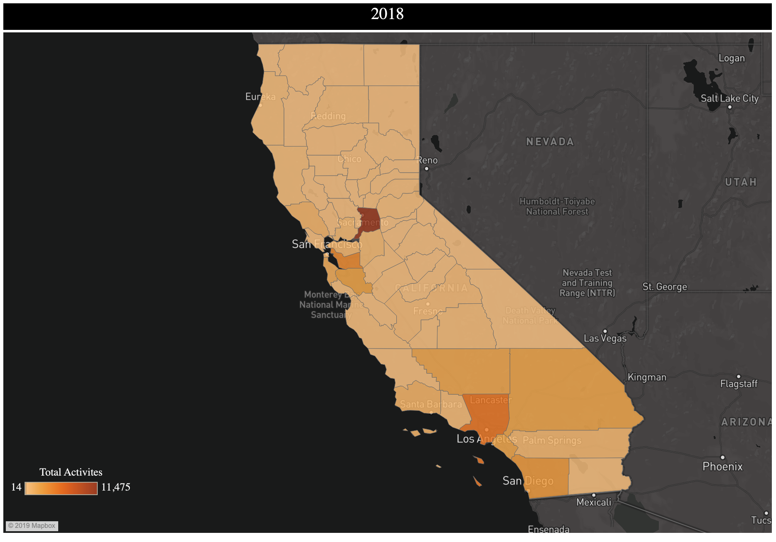
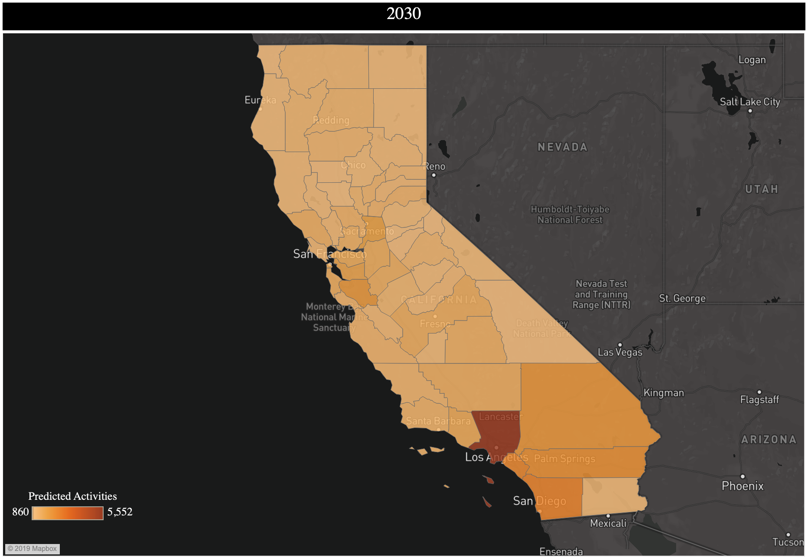
PREDICTING FUTURE REGULATORY ACTIVITIES
2018-2030
2018
2030
Notes:
Expected activities in counties in 2018 and 2030

Slide 4


PREDICTING FUTURE REGULATORY ACTIVITIES
2040-2050
2040
2050
Notes:
Expected activities in counties in 2040 and 2050

Slide 5
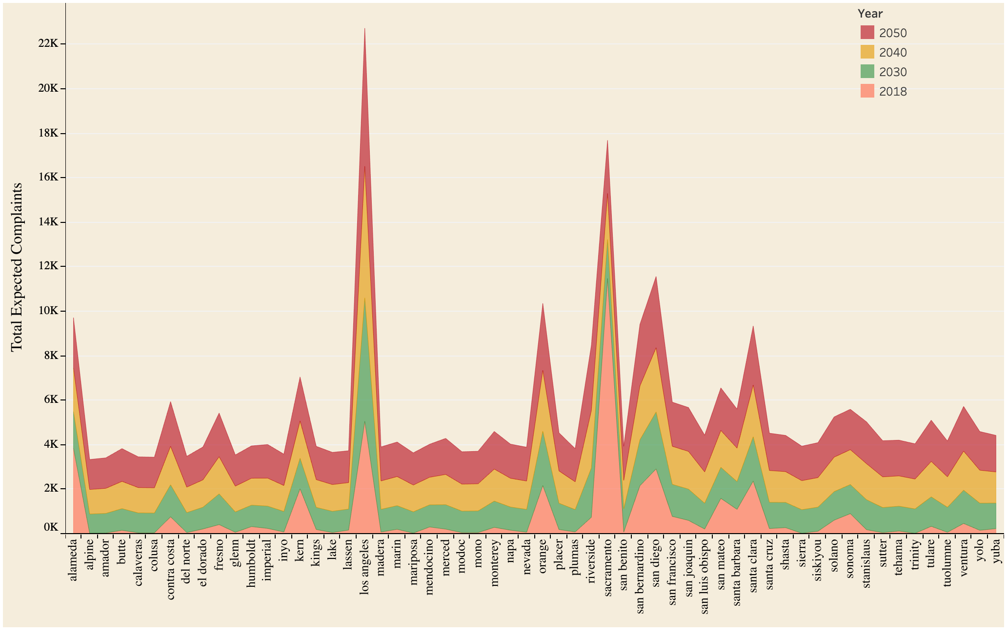
TOTAL EXPECTED ACTIVITIES/COUNTY
Notes:
Los Angeles expected to have around 22000 activities in the next 30-40 years, based on the expected population increase. This data could be used to help in staffing the water department in the counties. Higher the expected activities, more employees are needed to address the issues.

Slide 6
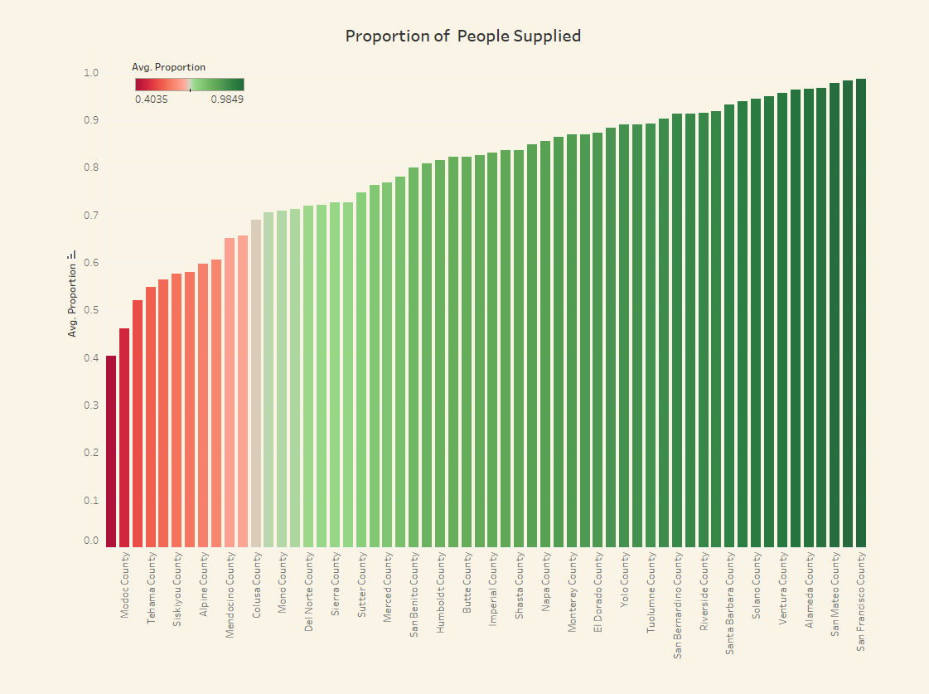
PROPORTION OF PEOPLE WHO WERE
PUBLICLY SUPPLIED WATER
Notes:
Publicly supplied water is equal to the amount of people that receive water from the County through their water system.
As we can see more Urban Counties have a higher proportion because they have more developed water systems.
Calculation = People who receive water/ Population

Slide 7
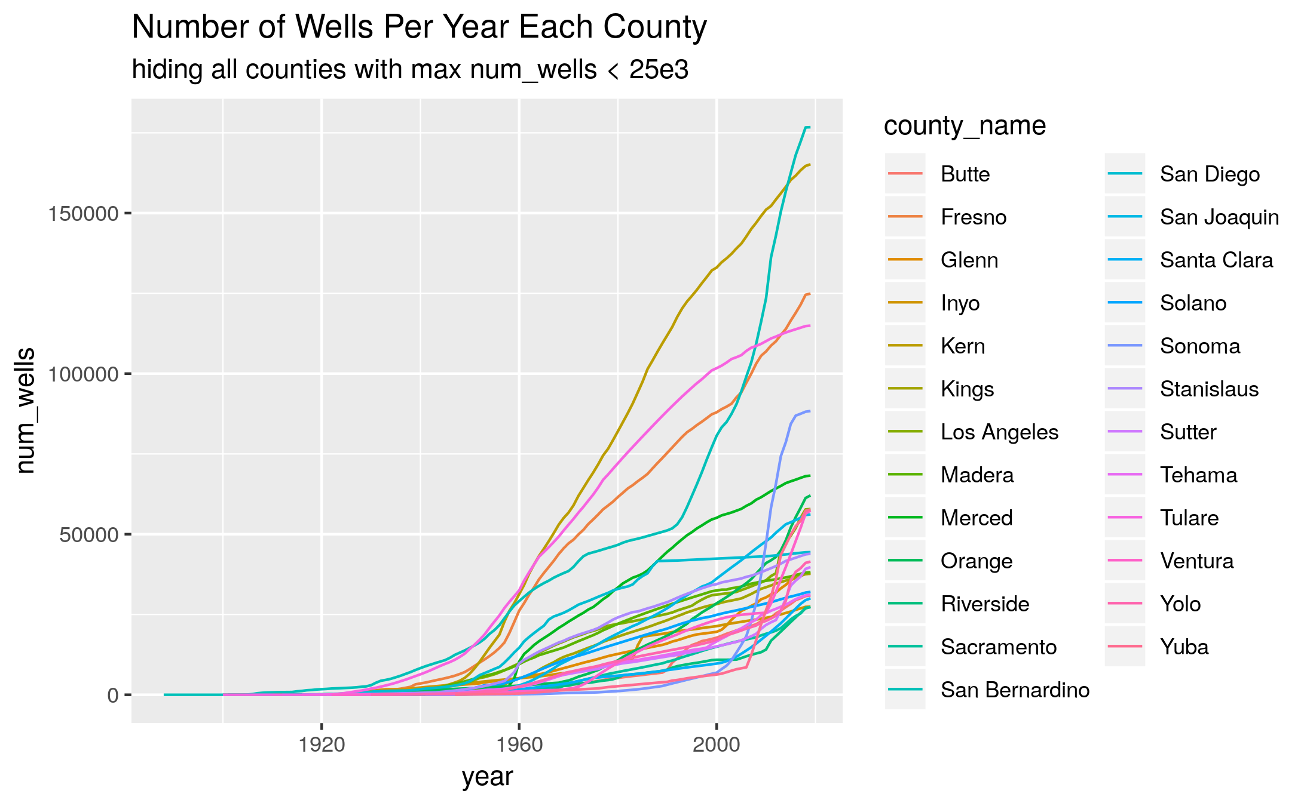
Most Wells in Agricultural Counties

Slide 8
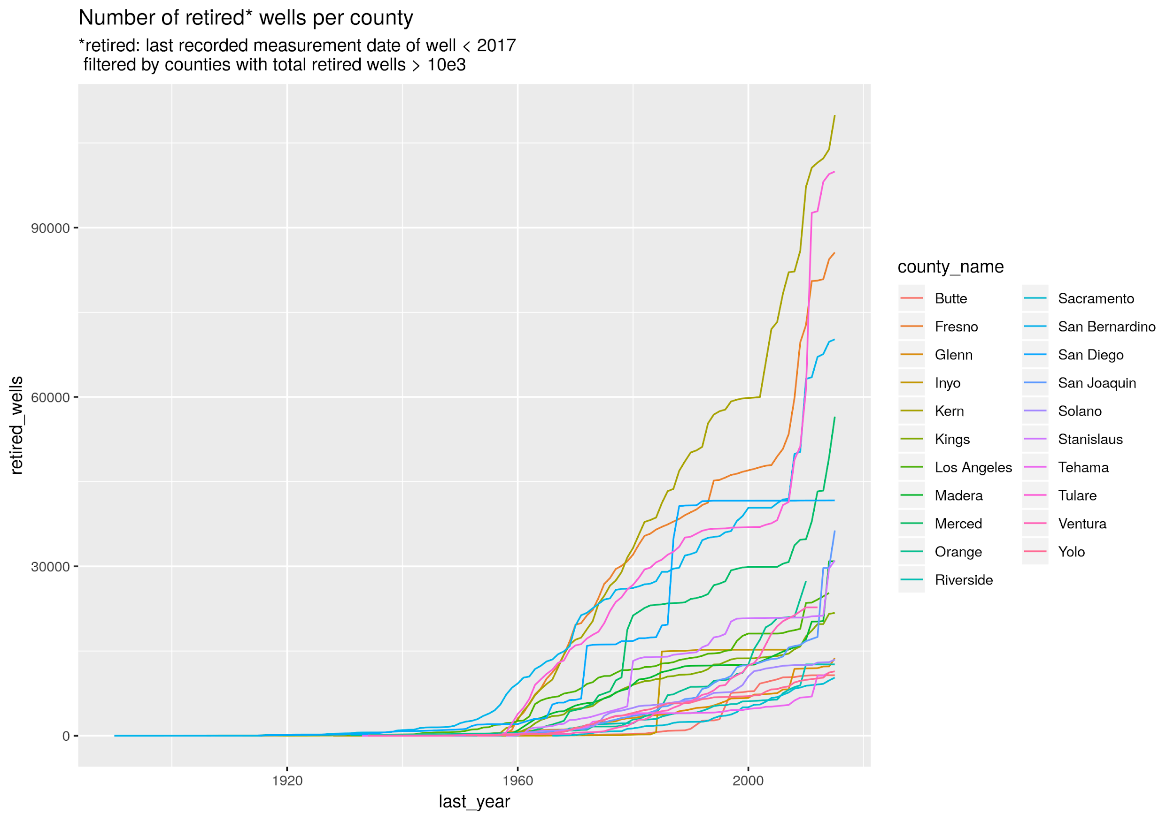

Slide 9
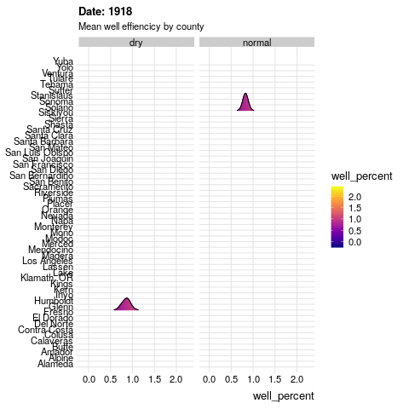
RATE OF WELL DEPLETION GREATEST IN AGRICULTURAL COUNTIES
Notes:
RATE OF WELL DEPLETION GREATEST IN AGRICULTURAL COUNTIES

